Slide 1
Health eDecisions Pilots
Virtual Open House demonstrating Applicability of Use Case 1
Notes:
Jamie

Slide 2

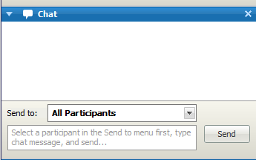
Meeting Etiquette
As a reminder all participants on this call are muted. If you want to ask questions or make comments please use the “Chat” feature on the web meeting
Send your “chat” to All Panelists in order to ensure the comments are addressed publically
To find the chat feature look for the chat bubble at the top of the meeting window
From S&I Framework to Participants:
Hi everyone: remember to keep your phone on mute ☺
All Panelists
Notes:
Jamie Parker

Slide 3
Clinical Decision Support to Health eDecisions - a brief history…
Content suppliers and EHR/PHR vendors all have proprietary formats and methods for exchanging, implementing, life-cycle managing, and executing CDS interventions
Each content supplier-EHR/PHR vendor integration for CDS exchange is unique
No widely accepted/adopted standards for exchange or services insertion
Even within a vendor, clients cannot always exchange content with each other
Healthcare systems with successful implementation of CDS are unable to share their proven interventions with others in an importable format, even if they wished to
Notes:
Ken

Slide 4
Health eDecisions
Initiative under Office of National Coordinators (ONC) Standards and Interoperability (S&I) Framework
Launched June 2012
Initiative Scope Statement: To identify, define and harmonize standards that facilitate the emergence of systems and services whereby shareable CDS interventions can be implemented via:
Standards to structure medical knowledge in a shareable and executable format for use in CDS, and
Standards that define how a system can interact with and utilize an electronic interface that provides helpful, actionable clinical guidance
May be included in Meaningful Use Stage 3
Focus of Use Case 1
Notes:
Ken

Slide 5
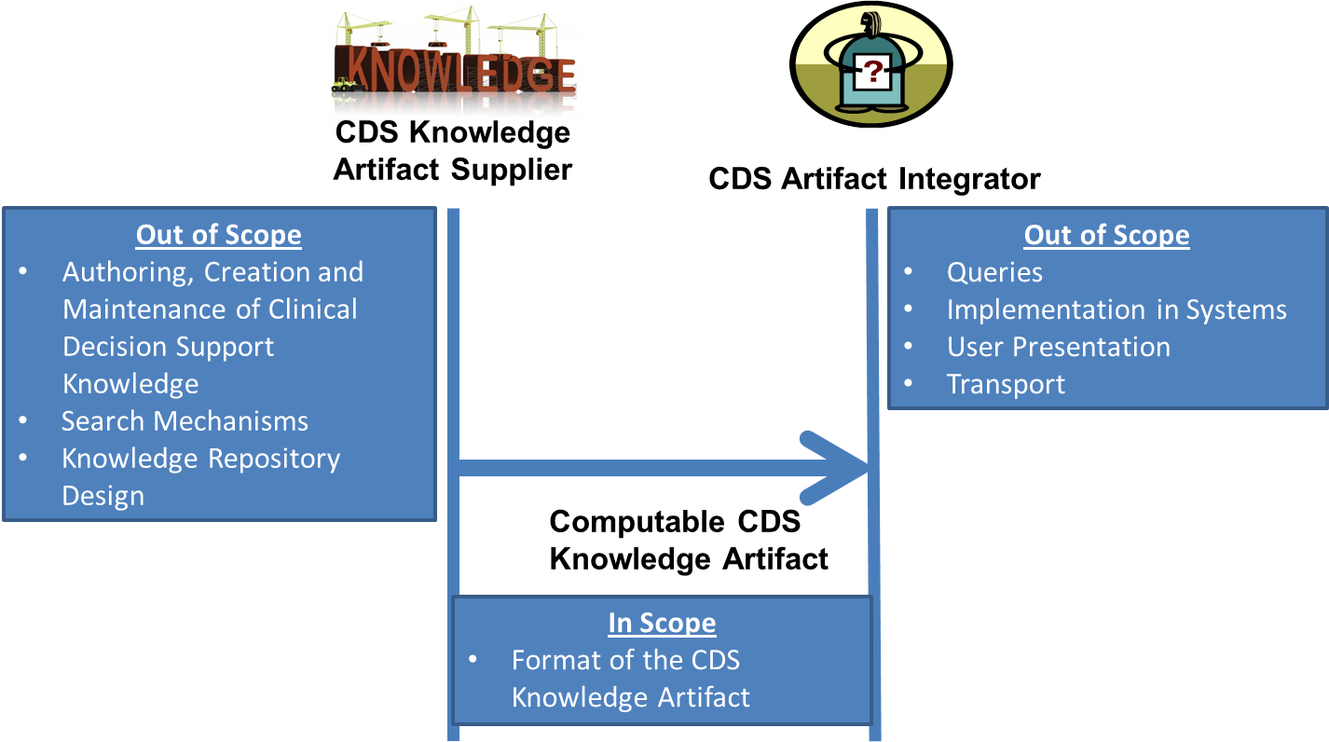
Health eDecisions – Use Case 1 (CDS Artifact Sharing)
Use Case 1 Focuses on three In scope artifact types:
Event Condition Action Rules
Order Sets
Documentation Templates
Notes:
Ken

Slide 6
HeD: Standards for UC 1
We evaluated several knowledge representation standards for CDS
CREF, CDSC L3, Arden Syntax, GEM, RuleML, GELLO, HQMF,…
We developed HeD Schema that harmonizes several of the above specifications
Notes:
Ken

Slide 7
HeD Artifact Schema Scope
Three types of artifacts currently in scope
Event-condition-action rules
Order sets
Documentation templates
The objective of the artifact schema is to allow specification of the knowledge content, but not how a CDS system should incorporate and execute this
We expect that most CDS systems will translate the artifacts into their native formats, rather than building execution engines for HeD
Notes:
Ken

Slide 8
HeD: Data Model for UC 1
We evaluated the following in support of UC 1:
vMR, FHIM, OpenEHR, QDM, CEM, CCDA/QRDA
vMR was chosen because:
It's designed for CDS and provides a more expressive model for reasoning.
It results in a more compact wire format, which is important for real-time calls, a big part of our use case requirements.
It already had container aspects designed for CDS, which are lacking in all the other standards
Notes:
Ken

Slide 9
HeD Pilots Goal
Goal
The goal of this initiative is to produce, consume and where feasible, execute implementable CDS interventions.
Event Condition Action Rules (ECA Rules)
Order Sets
Documentation Templates
Pilot Scope
Health eDecisions will apply defined aspects of the Implementation Guide in a real-world setting.
Modify the Implementation Guide to ensure it is usable
Submission of explicit feedback to sub workgroups such as vMR and vocabulary and terminology to close gaps
The real-world pilots evaluate not only the technology, standards and model (VMR), but also provide a test bed to evaluate the interaction of technology, implementation support, and operational infrastructure required to meet Health eDecisions use case 1 objectives at the stakeholder or organization levels.
Demonstrate intent of artifact (specifically structures and semantics) are communicated either by direct execution or by translation to native format
Ensure Completeness and consumability of artifact
Notes:
Jamie

Slide 10
Pilot Teams
EHR/Vendor | Artifact to Pilot | Content Supplier
Allscripts Robin Williams RN, Manager Solution Management Manoj Sharma Senior Software Engineer, Analytics & Information Business (AIB) | ECA rule: NQMF 068 Million Hearts™ Rule | newMentor Julie A. Scherer, PhD Chief Operating Officer
Allscripts Robin Williams RN, Manager Solution Management Manoj Sharma Senior Software Engineer, Analytics & Information Business (AIB) | ECA rule: San Diego Pertussis | CDC Shu McGarvey, CBAP (Northrop Grumman) Laura Conn, MPH (CDC Pilot Sponsor) Rita Altamore, MD, MPH (SME) Catherine Staes, , BSN, MPH, PhD (SME)
VA Kensaku Kawamoto, M.D., Ph.D. Director, Knowledge Management and Mobilization Assistant Professor, Department of Biomedical Informatics University of Utah Robert Lario MSE, MBA | Documentation Template: UTI (Partial History and Physical) | Wolters Kluwer Christy May, MS, RHIA
Design Clinicals Dewey Howell, MD, PhD Founder, CEO | Order Set: Heart Failure | Zynx Health Victor Lee , MD Vice President, Clinical Informatics Claude Nanjo Senior Software Architect
Notes:
Jamie

Slide 11
HeD Pilots Support Team Contacts:
ONC Sponsors
Jacob Reider :Jacob.Reider@hhs.gov
Alicia Morton: alicia.morton@hhs.gov
Joe Bormel: Joseph.Bormel@hhs.gov
Amy Helwig: amy.helwig@hhs.gov
Initiative Coordinator:
Ken Kawamoto: kensaku.kawamoto@utah.edu
Subject Matter Experts:
Aziz Boxwala: aziz.boxwala@meliorix.com
Bryn Rhodes: bryn@veracitysolutions.com
Support Team:
Project Management: Jamie Parker jamie.parker@esacinc.com
Use Case Development: Virginia Riehl: virginia.riehl@verizon.net
Standards and Harmonization: Anna Langhans anna.langhans@accenturefederal.com and Atanu Sen: atanu.sen@accenture.com
Notes:
Jamie

Slide 12
newMentor & Allscripts Overview of the Pilot
Goal
Translation of ECA rule from HeD to Allscripts CREF and accurate execution of ECA rule in the Allscripts CDS environment
Meaningful Use rule NQF 0068: Ischemic Vascular Disease (IVD): Use of Aspirin or Another Antithrombotic
Artifact supplier: newMentor
http://www.newmentor.com
Project lead: Julie Scherer
Artifact consumer: Allscripts
http://www.allscripts.com
Project lead: Robin Williams
Notes:
Julie

Slide 13
newMentor & Allscripts Operationalizing the Pilot
NQF 0068 ECA rule written to conform to HeD Implementation Guide and associated specifications
Pilot resources:
Clinical informaticist, knowledge engineers, software engineers, QA engineer, project manager
Standards and terminology:
HL7 Implementation Guide: Clinical Decision Support Knowledge Artifact Implementation Guide, Release 1
HL7 Version 3 Domain Analysis Model: Virtual Medical Record for Clinical Decision Support, Release 1
Vocabulary as recommended by HeD
Predefined eMeasure values sets from VSAC
Tools:
HeD XML schema validator
CREF translation plug-in for the HeD Artifact Utility
Allscripts test cases and testing environment
Notes:
Julie, Manoj, Robin and Bryn

Slide 14
newMentor & Allscripts Operationalizing the Pilot (cont.)
Findings:
Syntax translation was straightforward
Shared heritage of HeD and CREF provided very close mapping of operators
Data model translation required changes to the rule implementation
Negation rationale: observation of documented reason for not prescribing versus allergy to aspirin
Medication: aspirin as a substance versus antithrombotic therapy as a class
Procedures: performed procedure versus encounters with procedure code
Gaps in guidance modeling
Action models differed in messaging granularity, specificity of severity, and action proposal architecture
HeD rule implementation was modified to meet CREF requirements
Notes:
Julie, Manoj, Bryn and Robin

Slide 15
newMentor & Allscripts How Could Others Consume Our Work
Resources required:
Clinical informaticists knowledgeable about clinical content, clinical data models, and value sets
Knowledge engineers with expertise in the following:
HeD specification and implementation guide
HeD Artifact Utility and associated plug-ins
vMR clinical object model and terminology bindings
Artifact consumer’s data model and rules engine language
Terminology services and application of VSAC value sets
Software engineers
Quality assurance specialists
Notes:
Julie, Manoj, Robin, Bryn

Slide 16
newMentor & Allscripts How Could Others Consume Our Work (cont.)
Other considerations:
Documentation of workflow impact on clinical data model and rules execution
Analysis of the interdependence of actions and system messaging architecture
Use of terminology services and eMeasure value sets as appropriate
Fluency with vMR domain analysis model, HeD implementation guide, and templates for translation activities
XML translation samples, including different approaches to modeling concepts with strong workflow dependencies
Notes:
Julie, Robin, Manoj, Bryn

Slide 17
newMentor & Allscripts Lessons Learned
Terminology and value sets:
Use of predefined VSAC value sets for the NQF 0068 eMeasure by the author and consumer-facilitated interoperability
In situations where direct correspondence is not feasible, additional mapping will be required
Syntax mapping will be required in all systems, but once complete can be leveraged for future rules
ECA rule customization will be required to achieve accurate semantic translation, as patient and clinical data available in consuming systems are dependent on workflow and tools
Action messaging will vary in consuming systems, and HeD actions must must fit gracefully into current operating models
Notes:
Julie, Robin, Manoj

Slide 18
CDC & Allscripts Overview of an ECA rule Pilot
Pilot scope: An ECA artifact for San Diego County Pertussis was created for the reporter type of Healthcare Provider/Hospital.
Partners:
Artifact provider – CDC
Shu McGarvey, CBAP
Laura Conn, MPH
Catherine Staes,
Rita Altamore,
Artifact consumer - Allscripts
Aziz Boxwala, MBBS, Ph.D.
Bryn Rhodes,
Notes:
Shu

Slide 19
CDC & Allscripts Operationalizing the Pilot
The pilot was conducted following the steps below:
Data Collection – Data was collected and validated through a series of meetings with San Diego County. The data was captured in an Excel that held the “Who, What, When, Where and How” of reporting.
Initial Data Representation - This information was initially represented using an HQMF file, but while the format was intended to hold instructions (not patient data) it did not have the required flexibility for the content.
HeD File Creation - The information was then expressed as an HeD file.
File Translation - The HeD file translated to Allscripts’ CREF format.
File Consumption – Allscripts was able to successfully import the logic into their own clinical decision support system and were supportive of the effort to import knowledge in the future
Resources
Data Collection – PH Informaticist, PH Program SME, Vocabularist
File Creation – SME with expertise in format and vocabulary requirements of public health reporter.
Notes:
Shu

Slide 20
CDC & Allscripts Operationalizing the Pilot
HeD File Creation
Standards -Value sets for criteria (e.g., tests, results, specimen source)
Tool – XML Editor to create the HeD artifact, Bryn’s artifact utility to validate the artifact
Translation
Tool - HeD Schema Framework Artifact Utility to translate to Allscripts CREF specification
Developed the translation extension for CREF as part of the pilot
Notes:
For the translation, we used the HeD Schema Framework Artifact Utility to perform the translation to the Allscripts CREF specification. We developed the translation extension for CREF as part of the pilot.
As far as lessons learned, I think one thing that became clear is just how important the Value Sets and Terminologies work is. Where there is an established value set that both sides can reference, semantics can be correctly established and preserved through the translation, so that's an indispensable aspect of the HeD effort thus far.
Also, the discussion about "canonical" versus "covering" representations of concepts is something that I think is worth having. Even with the terminology mapping, that is something that needs to be considered as part of authoring content, as well as consuming content. This may have been more of an issue on the NQF-0068 pilot, but I think it did come up on the SDI pilot as well.

Slide 21
CDC & Allscripts Findings
We could represent the reporting criteria in a fully computable manner in HeD
HeD's expressivity exceeded that of the target's systems rule capabilities in one area (but there was an approach to achieve almost equivalent functionality in the vendor system)
The process revealed gaps in the vendor’s CDS (e.g., location of encounter), resulting in plans to add new capability based on lessons learned from the pilot

Slide 22
CDC & Allscripts Lessons Learned
Use real data
Value Sets and Terminologies are critical – it gives both sides an established set of values to reference, and provides the basis for semantics to be correctly established and preserved through the translation
Be open to where in the process changes should be made – it may point to reducing variation or complexity in the reporting specification, other times it may point to the HeD specification, or to the source system.
Consider “canonical” versus “covering” representation of concepts, where “covering” means the translation would need to consider the different ways in which source systems represented a concept and “canonical” would expect source systems to produce consistent data.
Notes:
For the NQF-0068 measure, we found during the translation that different source systems represented the same concepts using different classes. For example, a substance administration may be represented with a SubstanceAdministrationEvent, or with Procedure, depending on the source system. So the choice we had was to either change the artifact so that it looked for both types, or require the source systems to produce consistent data. Obviously the first option is easier, but it does raise the question of how best to handle this, and whether the artifacts should be written "canonically" or changed to accommodate these variances as a practical solution to the problem.

Slide 23
CDC & Allscripts Next Steps
Extend the approach to addition jurisdictions and conditions
“Templatize” the HeD file so the file could be automatically generated
Select more partners for translating/receiving and consuming the file
Complete the circle – partner with reporters involved in PHRI so that the reporting specification provided in the HeD file could be consumed and used to trigger generation of a public health report to a jurisdiction participating in the PHRI pilot.

Slide 24
CDC & Allscripts How can others consume our work
Business/Systems Analyst Expertise - to understand the public health requirements and determine:
Where they fit in the public health reporters’ flow
Gaps – with plan for addressing them
Informaticist and vocabularist
Translate the HeD file to the format needed by receiver
Map local vocabulary to standard vocabulary
Test file format and vocabulary. Test process.
Recommend and manage changes to format/vocabulary
Documentation:
https://code.google.com/p/health-e-decisions/source/browse/#svn%2Ftrunk%2Fsrc%2Fpilot
There are three files:
SDCPertussisClinical-eReportingCriteria.xml - the rule in HeD
SDCPertussisClinical-eReportingCriteria.CREF.xml - the rule in Allscripts format
SDCPertussisClinical-eReporting-Schematic.pptx - a graphical description of the rule
Notes:
Shu

Slide 25
Wolters Kluwer & VA Overview Documentation Template Pilot
Urinary Tract Infection (UTI) Documentation Template
Proof of Concept
Description: Converted a 12 page UTI documentation template for HPI for use in a clinical setting by a care provider.
Wolters Kluwer Health - CDS Knowledge Artifact Supplier
Stephen Claypool, MD
Scott Dyer, MD
Christy May, MS, RHIA
Joy Nisell, Informaticist
Howard Strasberg, MD, MS
http://www.wolterskluwerhealth.com/pages/welcome.aspx
Veterans Administration - CDS Knowledge Artifact Integrator
Aziz Boxwala, MBBS, Ph.D.
Ken Kawamoto, M.D., Ph.D.
Robert Lario MSE, MBA
Notes:
Christy

Slide 26
Wolters Kluwer & VA Operationalizing the Pilot
Resources Needed:
Clinical Content in the form of a documentation template (in this example, HPI for a UTI was utilized)
Informaticist able to write XML script
Terminology and Vocabulary knowledge
Software engineer - able to transform artifact into EHR environment
Model Driven Enterprise Architect (MDEA)
Standards Utilized:
HeD artifact definitions within the Implementation Guide which guided transformation of WK artifact into HeD artifact
MOF2Text, UML, MOF, QVT used in import and integrating HeD artifact into the VA system
Open Source Utilized:
Eclipse Acceleo, QVT, Ecore, OSGi also used in import and integrating HeD artifact into VA system
Notes:
Christy

Slide 27
Wolters Kluwer & VA Operationalizing the Pilot (con’t)
Harmonization:
Proof of Concept - sample of WK content and translated into the HeD schema per the IG, sent HeD artifact as a XML file
VA utilized an open source tooling from Eclipse.org to create a desktop tool
Developed Ecore Meta model based upon HeD XSDs
Assessed VA work product to determine variant and invariant aspects
Determined variant elements mapping to HeD meta model
Utilizing analysis of variant, invariant and meta model developed Acceleo (MOF2Text) template
Extended Eclipse (IDE) automate selection and transformation of source and target documents
Terminology:
SNOMED-CT
Evaluation & Management (E/M) Services
Consideration given to utilize LOINC codes in future to represent E/M Services
Notes:
Christy

Slide 28
Wolters Kluwer & VA How could others consume our work?
Wolters Kluwer would make the artifact template available to customers
HeD Implementation Guide to develop processes to import HeD artifact
Include use of tools:
Install the HeD plugin
Utilize existing transformations or add new transformations
Development of process to import and integrate content - this project used Eclipse Modeling IDE
http://www.eclipse.org/downloads/packages/eclipse-modeling-tools/keplerr
Documentation on the tooling and concepts can be found at:
http://www.eclipse.org/modeling/
www.omg.org
Notes:
Christy, Ken, Robert, Aziz

Slide 29
Wolters Kluwer & VA Lessons Learned
What we discovered
Appearance / display – more interactive template within the integrator system as it is independent of the artifact
Currently working on template that includes checkboxes
Include all elements of the H&P
Focused on HPI for the pilot but in the future would like to include: ROS, P/F/S History; Examination and Assessment / Plan
Terminologies included from supplier but were not utilized by integrator because they were not needed by the VA system.
Notes:
Christy, Ken

Slide 30


Zynx Health & Design Clinicals Overview of Order Set Pilot
CDS Supplier: Zynx Health
Claude Nanjo
Victor Lee
CDS Consumer/EHR Vendor: Design Clinicals
Dewey Howell
CDS Artifact Type: Order Set
Notes:
Claude

Slide 31
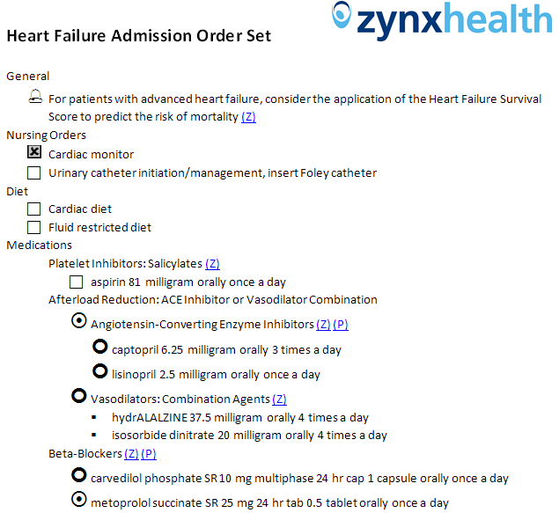
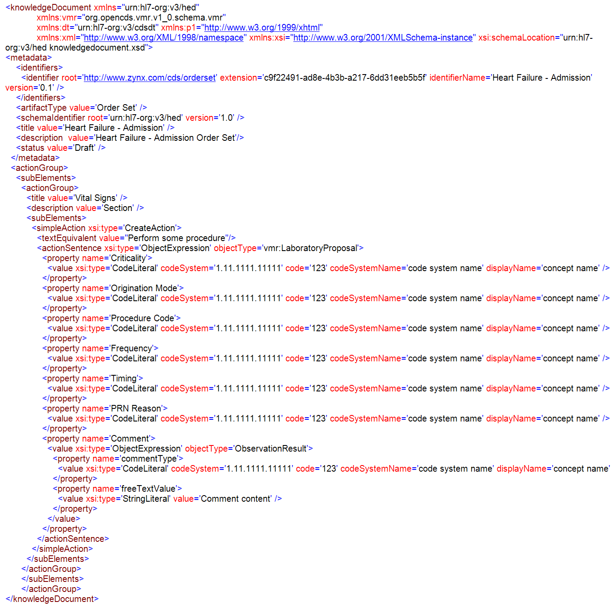

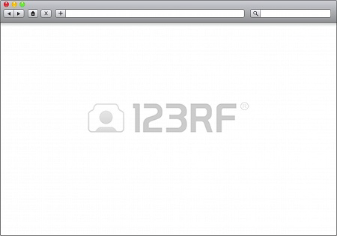
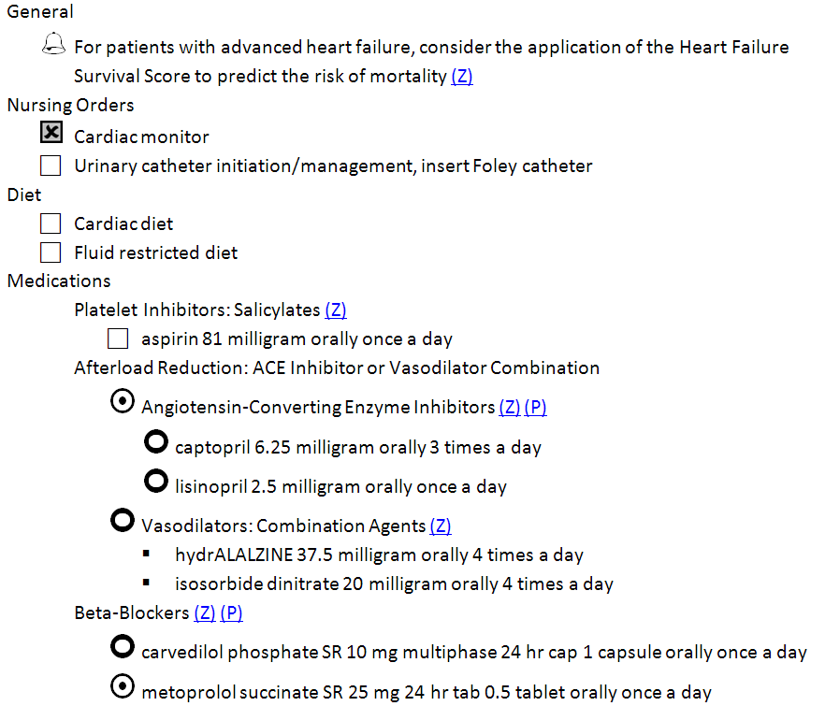

Zynx Health & Design Clinicals Use Case 1 Order Set Pilot
Notes:
Claude

Slide 32
Zynx Health & Design Clinicals Operationalizing the Pilot
Attempted to pilot the exchange of both “simple” and “complex” orders
Zynx Health (already familiar with HeD specification)
Coding lightweight HeD-compatible order set editor (300 person-hours)
Coding for conversion of native object model into HeD format, including testing (16 person-hours)
1 clinical resource to create the order sets and perform terminology mappings (6 person-hours)
Design Clinicals (initially unfamiliar with HeD specification)
Coding an import tool to deserialize an HeD artifact into native Design Clinicals object model (110-115 person-hours)
Coding efforts to persist contents to database were terminated
Point to point exchange was achieved while we improve terminology guidance
Notes:
Claude, Dewey

Slide 33
Zynx Health & Design Clinicals Lessons Learned
Recent updates to HL7 vMR greatly improved model expressivity
Standard terminologies may have too many options (eg, RxNorm: Ingredient, Clinical Drug or Pack, Dose Form Group, other choices) or may not be designed specifically to address order entry use cases and have gaps (eg, SNOMED CT, LOINC)
A standard terminology for orders would be helpful for CDS and would benefit Health eDecisions Use Case 1 and 2
Meanwhile, terminology guidance needs to be more prescriptive
Notes:
Claude

Slide 34
Zynx Health & Design Clinicals How could others consume our work
Become familiar with key HeD documentation:
HeD specification
HL7 vMR
Terminology guidance (HeD/vMR value restrictions)
View HeD artifact examples
Collaboration between technical and clinical resources
Notes:
Claude

Slide 35
In Support of Pilots: HeD Schema Framework Tool
HeD Schema Framework is a set of .NET technologies that serves as a foundation for implementing functionality related to the HeD Schema
For example, the following types of applications could be built using the foundation provided by this framework:
Semantic Validation
Translation
Evaluation
Visual Designers
Developed as Open Source with a Berkeley 3-Clause License
Hosted on Google Code Repository
http://code.google.com/p/health-e-decisions/
http://code.google.com/p/health-e-decisions/source/browse/trunk/src/framework/Deploy/HeDArtifactUtility_20130502.zip
Notes:
Bryn

Slide 36
HeD Schema Framework Tool Design Goals
Notes:
Bryn

Slide 37
HeD Schema Framework Tool Current Status
The Framework currently supports
Semantic Validation
Verifies correct types for all logic in the artifact
Verifies model property and object type references
Translation Infrastructure
Supports both syntax and model transformation
Translation to CREF
~70% complete syntax
~30% complete model transformation
In Progress
Schematron Validation
Update for vMR R2 (being balloted as part of UC2 work streams)
Notes:
Bryn

Slide 38
HeD Schema Framework Tool Translation Example
Notes:
Bryn

Slide 39
A word about terminology
As part of our pilot we recognized early on we needed a more complete set of terminology
Had a set of Data Elements form the Use Case
Expanded the list based on examples created for HL7 ballot
Needed value sets and other terminologies
Created a Terminology spreadsheet which contained value sets, definitions, codes sources etc.
Refining this spreadsheet to include mappings to QRDA, C-CDA
Notes:
Aziz

Slide 40

Questions

Slide 41
Resources
Wiki
http://wiki.siframework.org/Health+eDecisions+Homepage
Use Case 1
http://wiki.siframework.org/Health+eDecisions+Use+Case
HeD Schema Tool:
http://code.google.com/p/health-e-decisions/source/browse/trunk/src/framework/Deploy/HeDArtifactUtility_20130502.zip
Pilots
http://wiki.siframework.org/Health+eDecisions+Pilots
HL7 Ballot Submission:
http://wiki.siframework.org/Health+eDecisions+Reference+Materials#Ballot
UC 1 Harmonization and IG:
http://wiki.siframework.org/Health+eDecisions+Harmonization+and+Standards+%28Implementation%29
HeD Glossary
http://wiki.siframework.org/HeD+Glossary

